Slide 1



University of Toronto Fintech Bootcamp
Canadian Housing Market Trend
Quantitative and Qualitative data analysis of the Canadian Housing Market
Sadia Akbar
Benjamin Weymouth Mohamed Berrachdi
December 2021
Notes:
Sadia

Slide 2



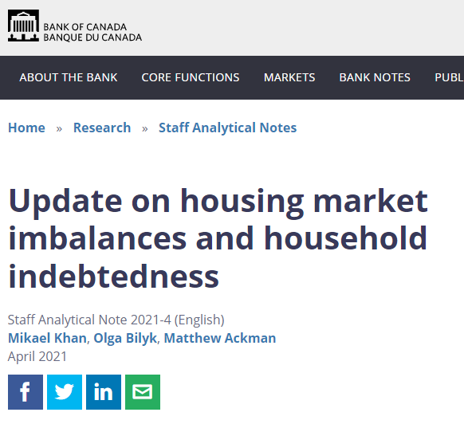
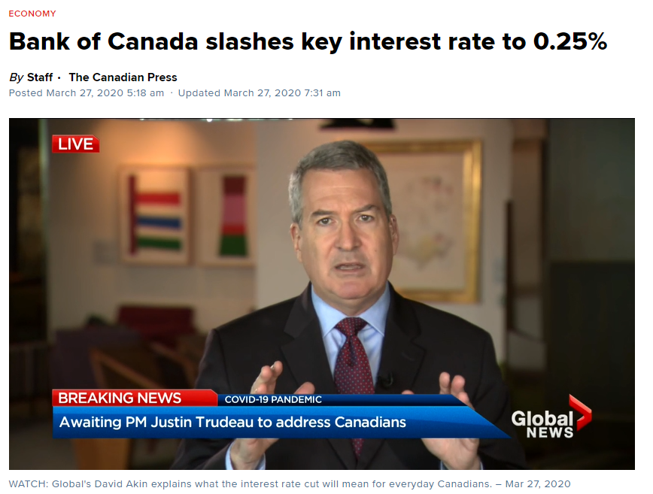
Hypothesis
We have seen issues in the housing market such as the financial crisis of 2008 that impacted the American economy for some years.
Our analysis will look at the long-term trends in the Canadian housing market to give us some indication of the future trends, such as a similar crash.
We will take both qualitative and quantitative data in order to make a conclusion for the future.
Notes:
Mo
During Covid the Canadian housing market saw extensive changes and turmoils in the market and major changes to the rates and numbers. Thinking back to the Financial Crisis of 2008 which was initially a Real estate and mortgage crisis, we wanted to look at the data and forecast possible or similar changes in the major rates;
We used both qualitative and quantitative data in order to draw conclusions

Slide 3
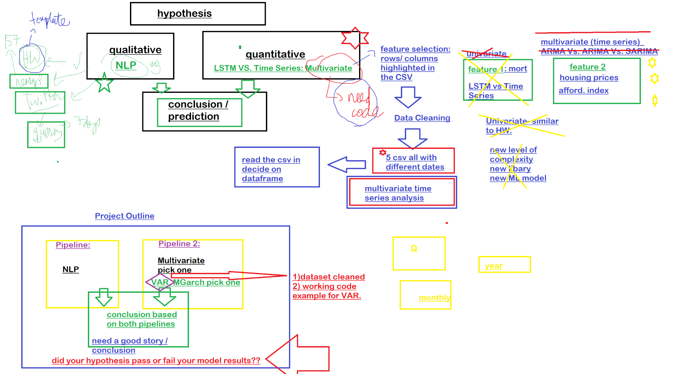
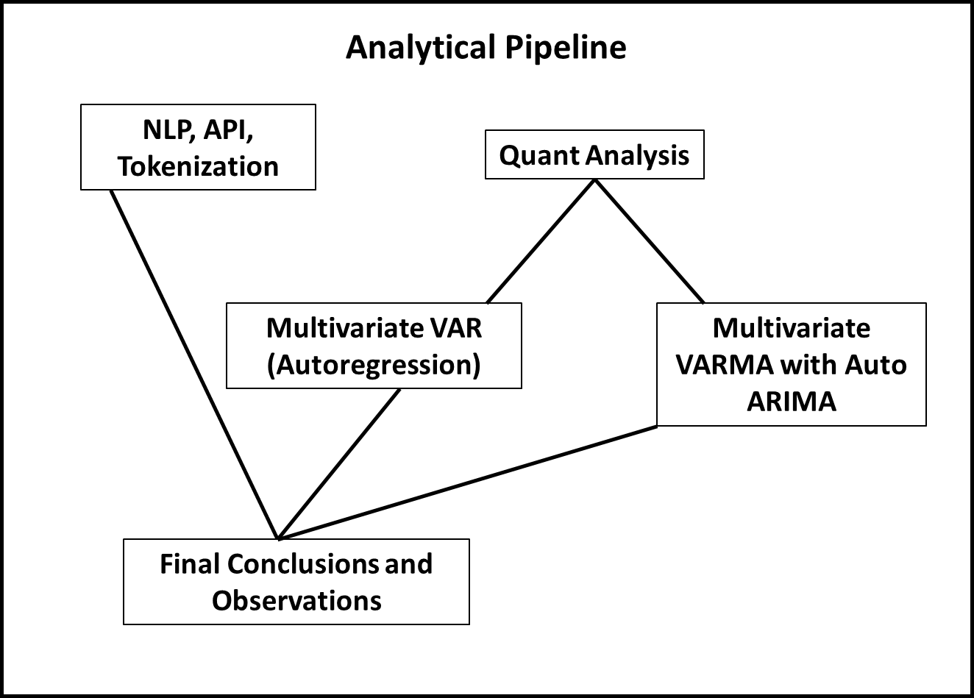
Introduction / Analytical Pipeline
Introduction / Analytical Pipeline
To start, this project has been an incredible learning journey with lots of brainstorming, debugging and learning.
Before / Brainstorming
Final Analytical Pipeline
Notes:
Ben- we began with many ideas, and ended up with the final analytical pipeline on the right.

Slide 4
Data Exploration
02
We had 3 factors to consider when we were researching our data:
Period of Time Covered
Source of the Data
Relevant to the Housing Market
We needed data sets that are official and public, and most importantly complete, due to the sensitive nature of the subject.
In order to be able to draw more accurate conclusions and train our model more efficiently, we needed data that covered at least 25 years or more.
We tried looking for different variants of the housing market that would be relevant to our analysis and tie it together.
We used official resources
Statistics Canada official website and datasets
Canada Mortgage and Housing Corporation
Notes:
Sadia -
Acquiring the right data was very essential for our analysis and therefore we focused on 3 main factors:
Period of time - we wanted data that covered at least 25 years and showed us an overtime trend
Source of data - but the data had to official, public, and complete
Relevant - and relevant to the housing market and each other
So we settled on Statistics Canada official website and the Canada Market Housing Corporation

Slide 5

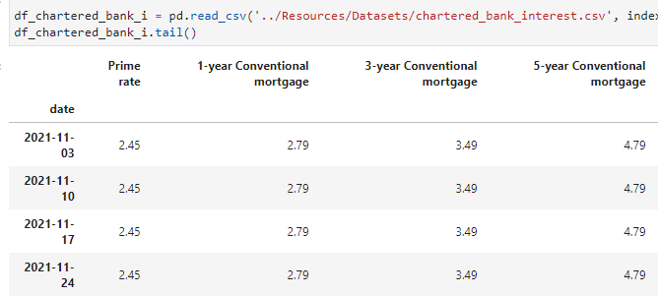
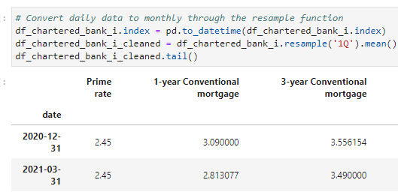
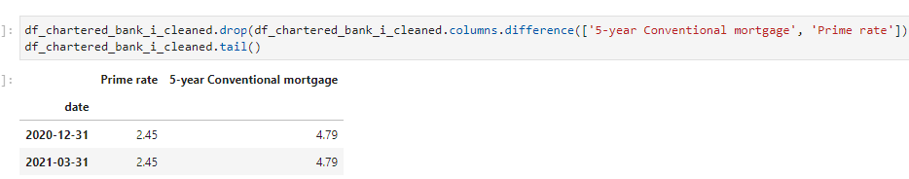
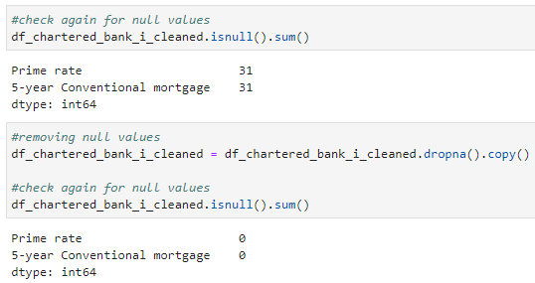
Data Cleaning
To get the four variables for our analysis we ingested data from 3 different csv’s, and each data set required a different cleaning process.
Prime rate and 5-year Conventional Mortgage rates:
In this csv, the data was not in a regular frequency (it was neither daily, monthly, or weekly).
To convert it into a uniformed frequency, we used the ‘resampling’ method and converted all the data from 1967 to 2021 into quarterly data.
Using ‘difference’, we dropped all unwanted columns and kept only the ‘Prime rate’ and ‘5-year Conventional Mortgage rate’ columns.
We also checked for and dropped all null values and saved the clean data to a new dataframe to concatenate and utilize in our analysis later.
Notes:
Sadia -
For our quantitative analysis we decided to work with 4 variables that would tie in together. We ingested data from 3 different csvs, each of which was in a different format and required a different cleaning process.
Using resampling method we converted data from all csv’s to same frequency of quarterly. However to point out we did incur errors when applying the resampling method as it does not recognise data that has an object datatype, which meant we had to check for and convert the columns to the correct format.
For one of the csv’s we had to use the Transpose method as the csv was in inverse format, that is, all dates were spread out horizontally in different columns
Using difference and truncate we dropped all unwanted columns
Sliced the data after reviewing each data set to match the dates, and combined into one clean dataset to start our analysis.
This meant getting data from different sources and combining it into one clean dataframe.
In our first csv the data was not in a regular frequency, that is, it was random dates, neither weekly, nor monthly or daily. Our first step was to make the frequency of the data more uniformed, which we did using the resampling method that frequented the dates and data to quarterly. Next using the ‘difference’ method we dropped the unwanted columns keeping the index, Prime rate and the 5-year conventional mortgage rate (most common) in Canada. We checked for and dropped null values and saved the clean dataset as a new data frame.

Slide 6
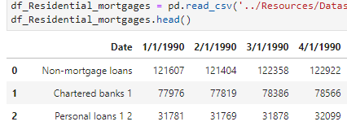
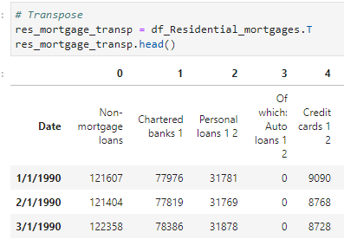
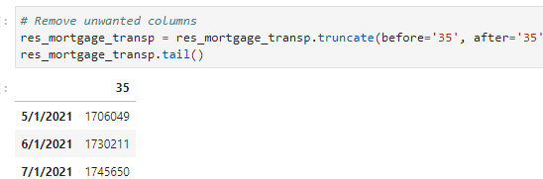
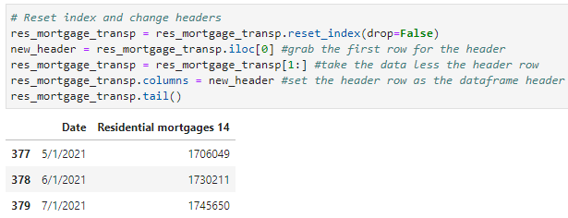
Data Cleaning
Residential Mortgages:
In this csv, although the data was monthly, it was in reverse format, that is, the dates were all horizontal, each in a different column, and the details in one column.
As this format did not match the first dataset, we used ‘Transpose’ (.T) to flip the data set converting all date columns into rows.
Using ‘truncate’, we removed all unwanted columns and kept only the ‘Residential Mortgages’ column.
The transpose method created two levels of headers/indexes; to correct this, we reset the date index column, and then replaced the first header with the second (correct) header using ‘iloc’.
Notes:
Sadia - For our second csv although the data was in a regular monthly frequency, it was in reverse format, that is, the dates were spread out as different columns, so our first step was to transpose the dataset using the ‘Transpose’ method or ‘.T’. We used the truncate function to drop all the unwanted columns and kept the index and the Residential Mortgages column.
The transpose method created two levels of headers/indexes; to correct this, we reset the date index column, and then replaced the first header with the second (correct) header using ‘iloc’.
Using resampling method we converted data from all csv’s to same frequency of quarterly. However to point out we did incur errors when applying the resampling method as it does not recognise data that has an object datatype, which meant we had to check for and convert the columns to the correct format.
For one of the csv’s we had to use the Transpose method as the csv was in inverse format, that is, all dates were spread out horizontally in different columns
Using difference and truncate we dropped all unwanted columns
Sliced the data after reviewing each data set to match the dates, and combined into one clean dataset to start our analysis.

Slide 7
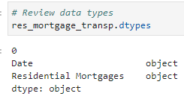
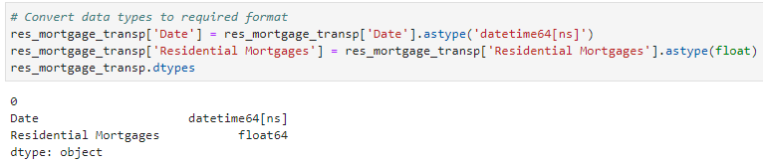
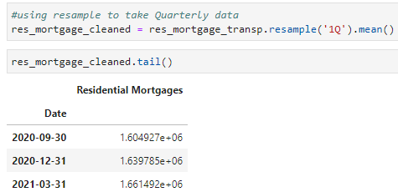
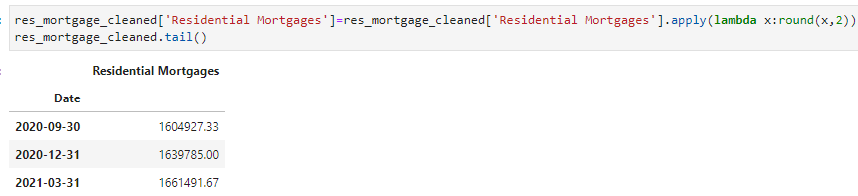
Data Cleaning
Residential Mortgages (continued):
To correctly carry-out the resampling of the data we had to check and convert the format of the date and Residential Mortgages columns.
As resampling does not work on or recognize data that is an ‘object’ data type. And since both our columns were in the ‘object’ format we converted the date column to ‘datetime’ and the Residential Mortgages column to ‘float’.
Using the ‘resampling’ method we then converted the data into quarterly frequency.
Using lambda, converted the format of the values in the Residential Mortgages column. We also checked for and dropped all null values and saved the clean data to a new dataframe to concatenate and utilize in our analysis later.
Notes:
Sadia - Our next step was to change the frequency of the data from monthly to quarterly. But the resampling method gave us error when tried to run it as resampling does not recognize datatype object . So we had to convert the date column to datetime and Res Mort column to float. This allowed us to use resampling an change the frequency of the data to quarterly. We corrected the format of the res mort columna and checked for and dropped null values and saved the clean dataset as a new data frame.
Using resampling method we converted data from all csv’s to same frequency of quarterly. However to point out we did incur errors when applying the resampling method as it does not recognise data that has an object datatype, which meant we had to check for and convert the columns to the correct format.
For one of the csv’s we had to use the Transpose method as the csv was in inverse format, that is, all dates were spread out horizontally in different columns
Using difference and truncate we dropped all unwanted columns
Sliced the data after reviewing each data set to match the dates, and combined into one clean dataset to start our analysis.

Slide 8
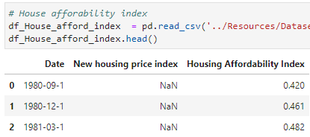
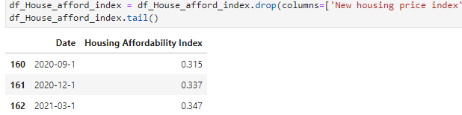
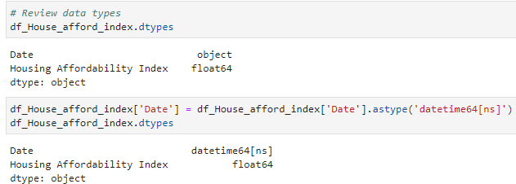
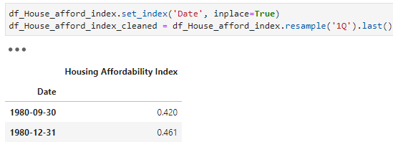
Data Cleaning
House Affordability Index:
In this csv, the data was already in a quarterly format, but the dates showed the first of the quarter instead of the last of the quarter.
Before changing the dates, we dropped the unwanted column and kept the date and Housing Affordability Index columns.
Next, we checked for data types and converted the date object column to datetime, set it as the index and ran the resampling method to change the dates from first to the end of the quarter to match the clean dataframes.
We checked for and dropped all null values and saved the clean data to a new dataframe to concatenate and utilize in our analysis later.
To match the date ranges of the three different dataframes, we sliced all three data frames to only keep data from first quarter of 1990 to the second quarter of 2021, that is, “1990-03-31 to 2021-06-30”.
Using the concat function we combined the three dataframes to one, and called it ‘housing_analyis_combined_df’.
Notes:
Sadia - In our third csv the data was already in quarterly but with wrong dates, that is, beginning of the end of quarter instead of the end of the quarter, before the converting the dates we dropped the unwanted column (just one in this case), and before moving on to resampling made sure the other columns had the correct datatype. So we had to change the date column from object to date time and set it as the index. Followed by the resampling method which corrected the dates and last we checked for and dropped null values and saved the clean dataset as a new data frame.
Our final step was to slice the data to a certain date range, we chose 1st qtr of 1990 to 2 qtr of 2021 after reviewing all three dataframes. and using the concat function, we combined the three datasets into one dataframe.
Using resampling method we converted data from all csv’s to same frequency of quarterly. However to point out we did incur errors when applying the resampling method as it does not recognise data that has an object datatype, which meant we had to check for and convert the columns to the correct format.
For one of the csv’s we had to use the Transpose method as the csv was in inverse format, that is, all dates were spread out horizontally in different columns
Using difference and truncate we dropped all unwanted columns
Sliced the data after reviewing each data set to match the dates, and combined into one clean dataset to start our analysis.

Slide 9
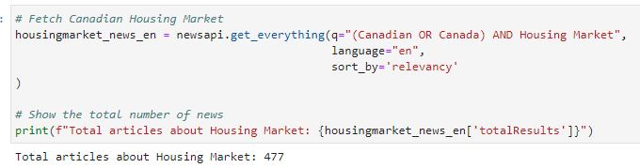

Analysis
Qualitative Analysis
Draw Articles from News API
Fit it into a DataFrame
Apply Sentiments Analysis Scoring
Plot Results and WordClouds
1
2
3
4
Notes:
Mo
Add graph with negative
Our analysis consisted of:
Sentiment Analysis
We used the newsapi to pull the latest news articles for the Canadian Housing Market but noticed that newsapi had a limited timeframe and didn’t give us articles older than 1 month. Results showed that a total of 477 articles mentioned, “‘Canadian’ or ‘Canada’ Housing Market”.
For our qualitative data analysis we applied Natural Language Processing to understand the sentiment in the latest news articles featuring the Canadian Housing Market.
We also tried to utilize the fundamental NLP techniques and tried to understand the other factors involved with the housing market such as common words and phrases and organizations and entities mentioned in the articles.

Slide 10
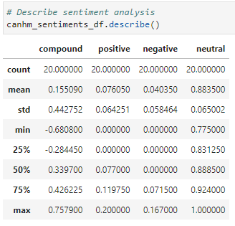
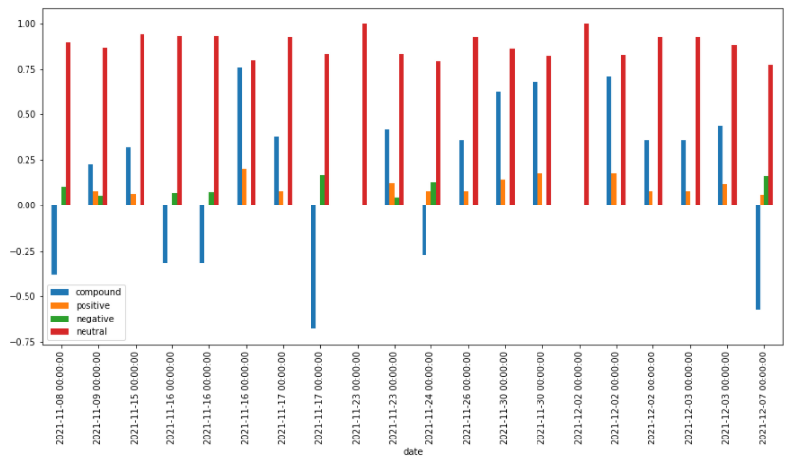
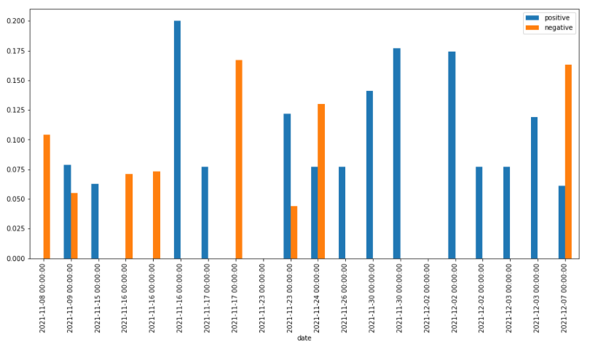
Analysis
Sentiment Analysis
From the articles we created a DataFrame of sentiment scores. Which we plotted to see the trends
Notes:
Mo
Add graph with negative

Slide 11
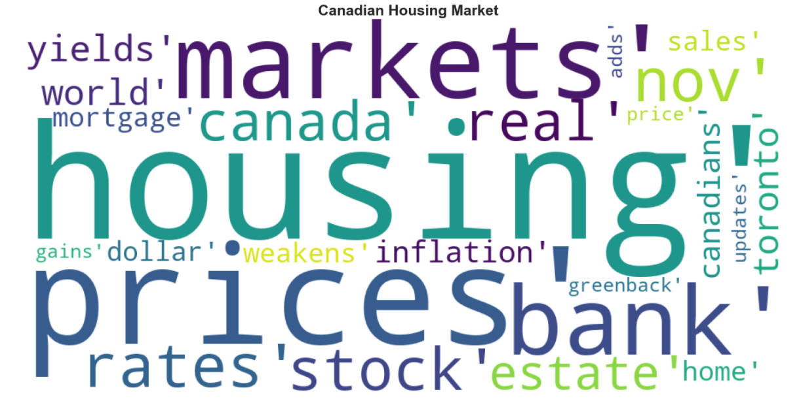
Analysis
Natural Language Processing
We used NLTK to tokenize text, find n-gram counts, and create a word cloud.
Notes:
Mo
Add graph with negative

Slide 12
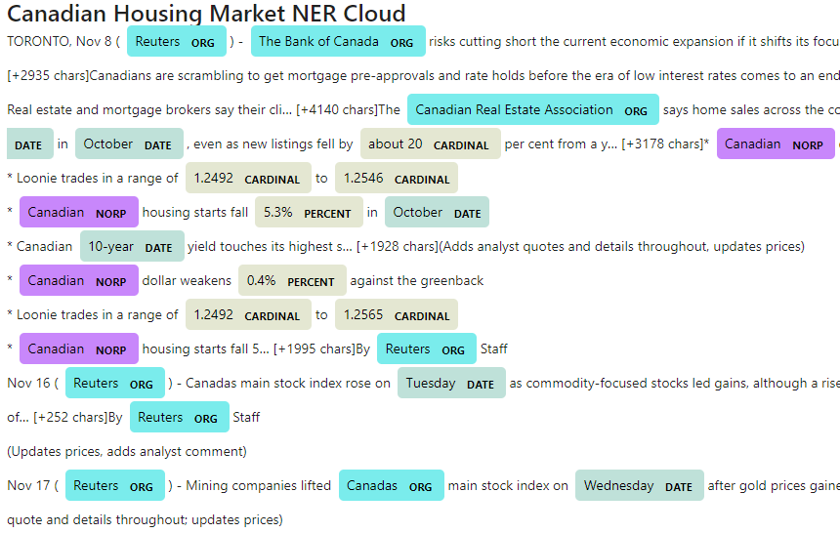
Analysis
Named Entity Recognition
We tried to build a named entity recognition model (NER) for the Canadian Housing Market and visualize the tags using SpaCy.
Notes:
Mo

Slide 13
Analysis
02
Quantitative Analysis
Data Exploring
Multivariate Time Series
VARMA with Auto ARIMA
The VAR model is designed for multivariate analysis, which is suitable for a predictive analysis that requires more than one variable. With the VAR model, each variable is modeled as a linear combination of past values of itself and the past values of other variables in the system.
In this study we will compare two different multivariate tools to pick the best. In this slide let’s review the two models that are under comparison. Each model will utilize a slightly different algorithm and has slightly different processes under the hood.
V stands for the vector, which is indicating that it’s a multivariate model. AR stands for autoregression which looks at the previous values. MA for moving average, and X for the use of exogenous variables. An exogenous variable is a variable that is not affected by other variables in the system.
VAR: Vector Autoregression
Notes:
Ben

Slide 14
Analysis
Quantitative Analysis
Steps and Prerequisites for VAR: Vector Autoregression:
The data must have stationarity and should be passed into the model after a cointegration test.
We will use Grangers and an Augmented Dickey Fuller Test to check for stationary data.
Differencing should be used for data that is not stationary
Using selectorder() method to take a specific best lag
Use De-Differencing: Invert the transformation to get the real forecast
Take the RMSE Values to forecast the accuracy of the Model
Steps and Prerequisites for VARMA with Auto Arima
If we are to utilize the VARMA with Auto Arimal model, the process is similar with some changes
we found some resources that showed that the differencing in Auto-ARIMA might not be perfect.
Therefore, we continued to use differencing and de-differencing as before. However, we are also using AUTO ARIMA here. Which provides for the best p and q values.
Run VARMAX with p and q values
De-Differencing The Results
Take the RMSE Values to forecast the accuracy of the Model
Notes:
Ben

Slide 15

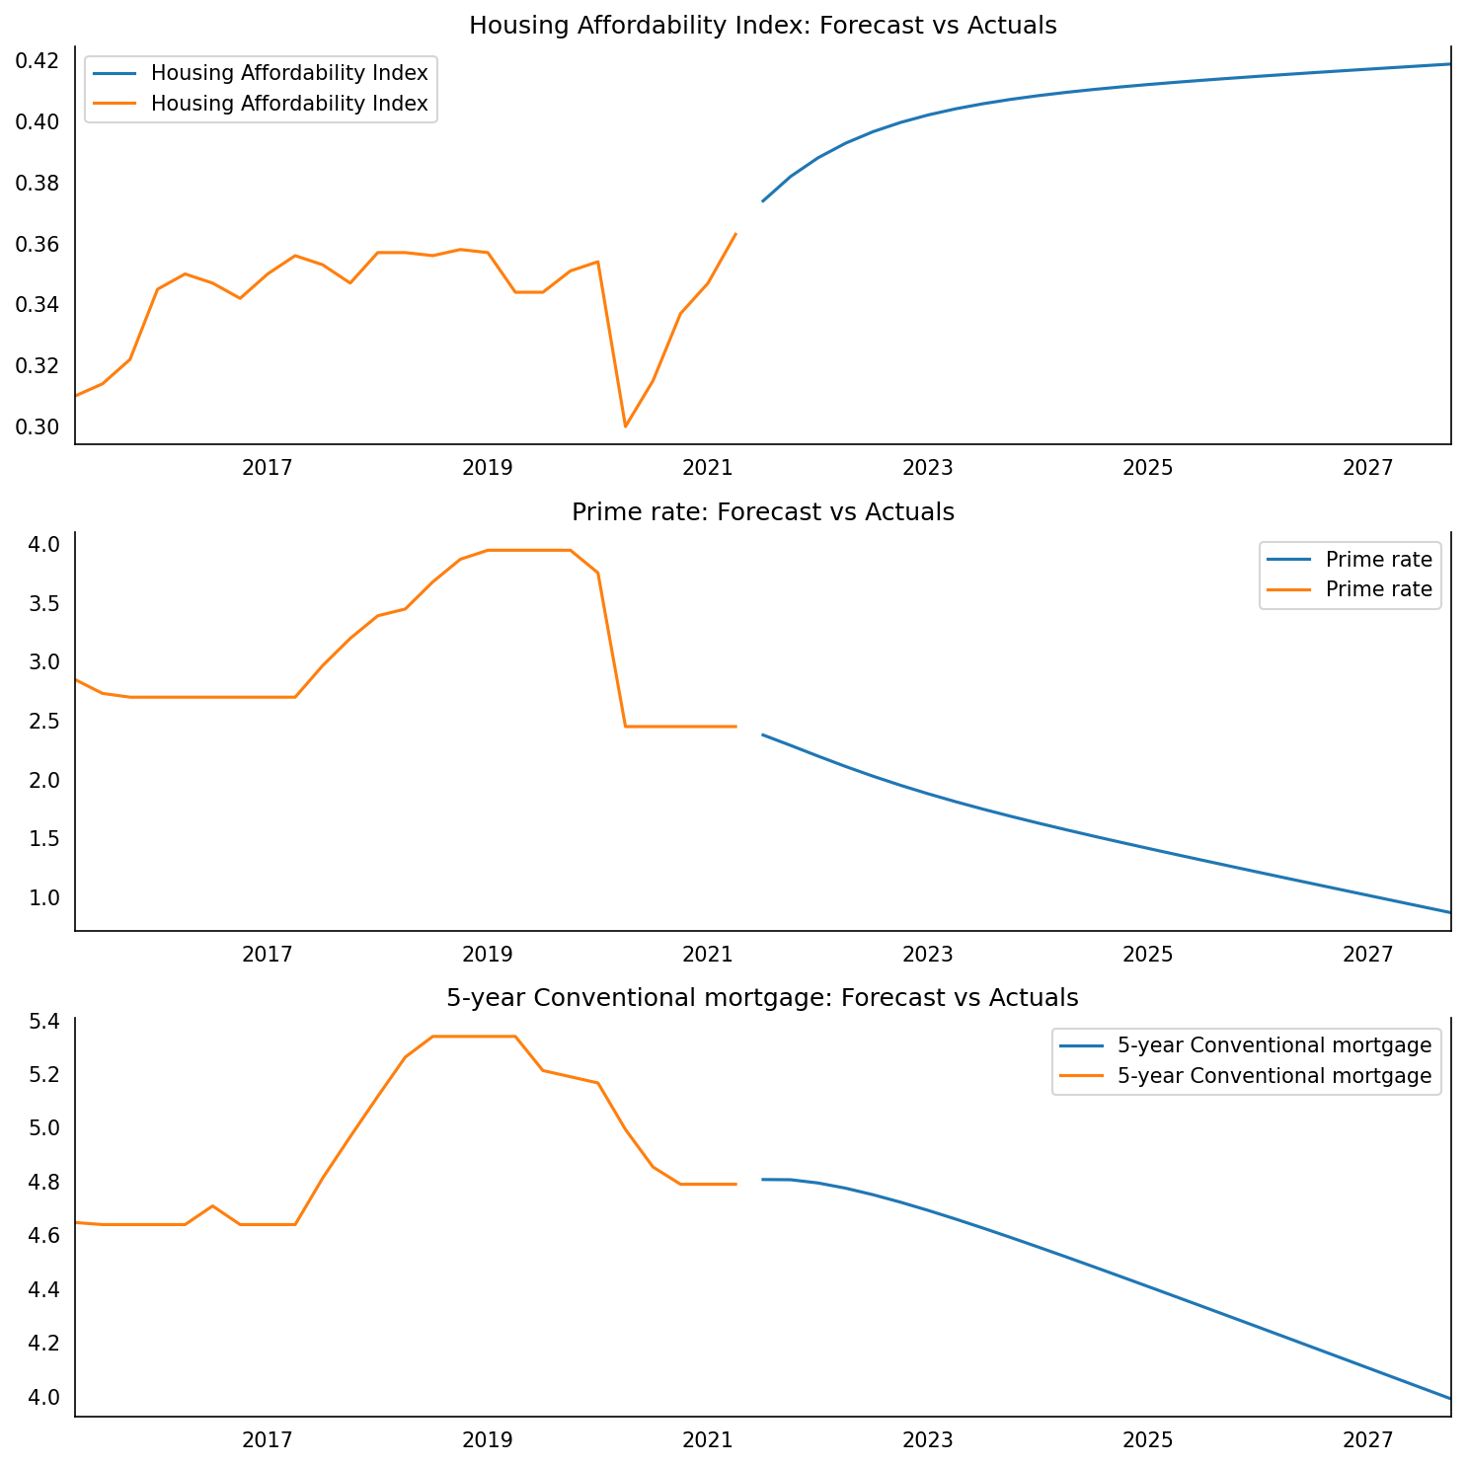
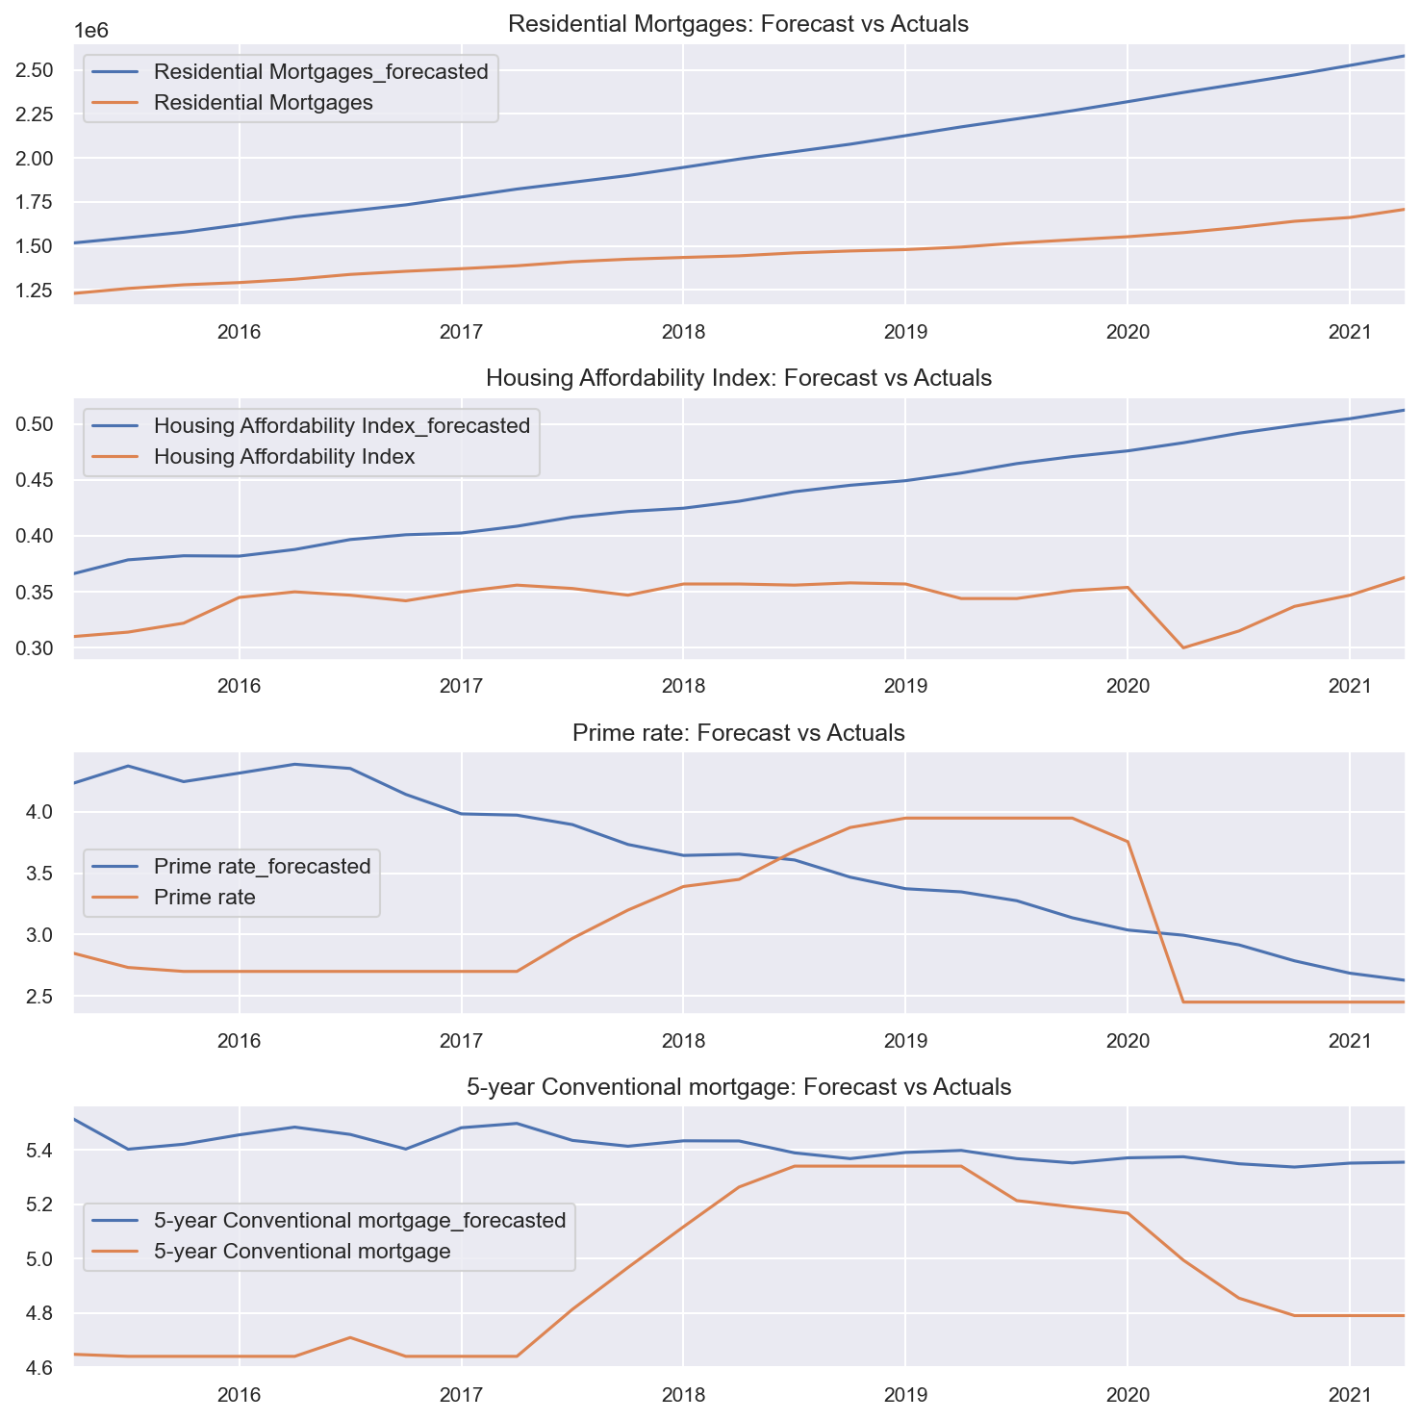
05
Multivariate Model Comparison:
Can you guess which output fits which model?
Notes:
Ben

Slide 16
Model Comparison: Quiz results
VARMA: w Auto ARIMA
VAR: Vector Autoregression

Slide 17
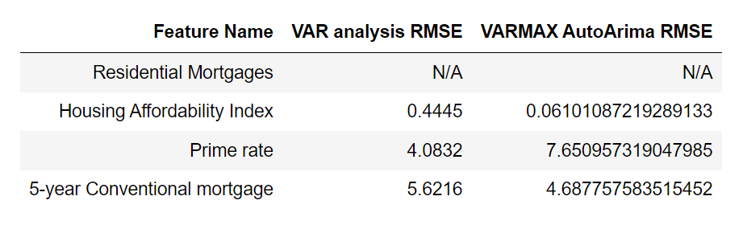
Multivariate Model RMSE Comparison
We know that if we have a lower Root Mean Square Error (RMSE) value, then we have a better fit in the model
Here it is a good measure of how accurately the model will be predicting the Housing Trends in Canada.
And thus we can say that it is the most important attributes when evaluating a model.
Notes:
Ben Root Mean Square Error (RMSE) is the standard deviation of the residuals (prediction errors).

Slide 18
Multivariate Model Comparison: Conclusions
It is very close between the two models. The sum() of VARMAX gives a total of about 11, and VAR about 12.
Residential Mortgages did not give us a useful RSME in either case, as the differencing did not produce stationary data.
Therefore we can compare our two different models on the basis of the other values.
Utilizing that framework, the values are slightly better for the VARMAX Auto-ARIMA model, and therefore the VARMAX model can be said to be a better fit.
However, it should be noted that these models are statistically very similar in their RMSE values, and therefore the VAR model is not deficient in our analytical toolkit.
Notes:
Ben

Slide 19
Conclusions / Analytical Outcomes
The quantitative conclusion is that the current large trends will continue with some peaks and valleys. In short, since the Housing Affordability Index predicted to go up- this means that it will be more difficult for Canadians to afford a home. Both VAR and VARMAX models support this conclusion.
Quantitative Conclusion
The Negative sentiment articles in the canadian press rose significantly during the last period corroborating our quantitative results of a an imminent change in the actual trends, there is a significant worry about the change in the Canadian Housing Market especially with the retraction of the low interest rates introduced during Covid by Bank of Canada making mortgages higher and driving the loans rates to a newer high.
Qualitative Conclusion
We conclude that from both pipelines, there is a an imminent change coming which would align with the downturn that was in our hypothesis.
Overall Conclusion
Notes:
MO

Slide 20
Insights and Next Steps
Work With More Models
Work with More Variables
Work With Twitter API
News API
Work with Multivariate LSTM and find better data to use it
Volatility analysis with Multivariate GARCH
Use Endogenous variables to the Housing Market and study their effect on our data
Match the prime rate with the inflation rate
Include more types of loans in the models
Work with other Indexes alongside the HAI
Work with the housing prices as well as the Residential mortgages
Get elevated access to Twitter API
work on larger tweets
combine the results from twitter with the results from News API
Better Api
Larger Number of articles
Longer period of time covered
Notes:
MO
More Models :
( ie : Lumber prices effect on Housing prices as an example
International trade effects
News API:
The initial acces we had to news API which is the academic level would allow us to only work on articles dating to one month back, although we obtained a large enough number of articles, we would spend more time on acquiring access to a larger API with better coverage, but request for access are
Twitter API:
Although we tested out a Twitter initially and wanted to use the website as a second resource of Qualitative data and Market Sentiment analysis, we were limited by the acces we had since getting an elevated access that allows
Work with more variables:
We worked Housing Affordability Index, Residential mortgages, Prime rat and 5 year conventional Mortgage

Slide 21

Thank you.
Any questions?

Slide 22
References:
https://github.com/Apress/hands-on-time-series-analylsis-python/blob/master/Chapter%204/7.%20VARMA%20with%20Auto%20Arima.ipynb
https://learning.oreilly.com/library/view/advanced-forecasting-with/9781484271506/html/508548_1_En_10_Chapter.xhtml
https://github.com/xxl4tomxu98/econometrics-gdp-dpi-VAR/blob/main/real-world-VAR.ipynba
https://www.machinelearningplus.com/time-series/vector-autoregression-examples-python/
https://www.analyticsvidhya.com/blog/2018/09/multivariate-time-series-guide-forecasting-modeling-python-codes/
Image (Thank you Slide):
https://www.ft.com/content/8cb9f0fa-0a61-11e8-839d-41ca06376bf2

